Slide 1
Lesson 1.6
HTML Tables

Slide 2
Learning Outcomes
Use HTML to create tables
Indent lines
Manage table rows and table columns
Merge different rows and columns of a table as per the requirement

Slide 3
HTML Tables
Websites consist of a series of rectangular boxes
The <table> HTML element represents tabular data
2D table comprised of rows and columns of cells containing data
You can have as many rows and columns as you like in a table
Make sure that the number of cells are the same in each row
Other HTML elements can be inserted into cells
Nesting tables:
Possible, but not recommended!

Slide 4
HTML Tables
Required elements in a table:
<table></table>
Table element itself
<tr></tr>
Table row
<td></td>
Table data (cell)
Determines the number of columns!
Useful elements in a table:
<th></th>
Header data (cell)

Slide 5
HTML Tables
Optional elements in a table:
<caption></caption>
Defines a table caption. Functions like a heading for a table.
Inserted immediately after the <table> tag
Important for accessibility
<colgroup></colgroup>
Specifies a group of one or more columns in a table for formatting
Useful for applying styles to entire columns, instead of repeating the styles for each cell, for each row

Slide 6
HTML Tables
Optional elements in a table:
<thead></thead>
Used to group header content
<tbody></tbody>
Used to group the body content
Enables scrolling of the table body independently of the header and footer
<tfoot></tfoot>
Used to group footer content
<thead>, <tbody>, and <tfoot> can be used to:
Add styling using CSS
Allow for better printing

Slide 7
HTML Tables
Useful table attributes:
border=“[value]”
Adds a border of width [value] around the table
Example: <table border="1">
colspan=“[value]”
Defines the number of columns a cell should span
Example: <td colspan=“2”>
rowspan=“[value]”
Defines the number of rows a cell should span
Example: <td rowspan=“2”>
Deprecated attributes
Best practice is to use CSS to style HTML tables instead of HTML table attributes.
Notes:
CODEPEN: Table examples

Slide 8
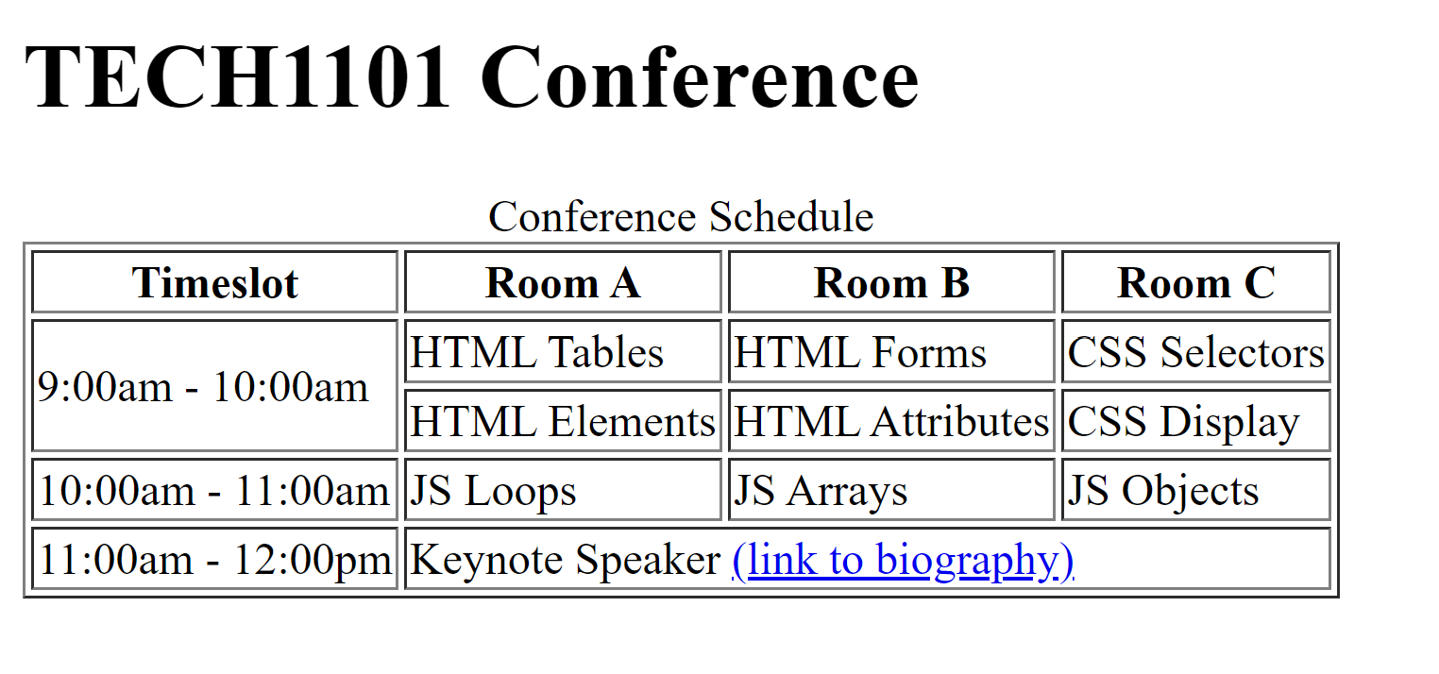
Practice Activity
Notes:
Recreate this table in HTML only.

Slide 9
Learning Activities
1.6.1 – “Create an HTML Table as per the given format”
1.6.2 – “Add Work Experience to Your Personal Website”

Slide 10
GLA 1
“Format a web letter and check your HTML proficiency”

Slide 11
For next class
Read Lesson 1.7
Do Learning Activities 1.7.1, 1.7.2
Assessments Reminder:
GLA 1 is due by February 13, 3:30pm
Engagement is worth 10% of your final grade. Engage by sharing code, asking or answering questions, etc.
All assessment dates have been posted in the D2L calendar.
See the “Assignments Policy” for late submission procedures.

Slide 12
References

